Slide 1











Roey Fabian, Ron Sharabi, Amit Cohen, Eren Fishbein
Vox Populi Platform
Open-source framework
for data collection from
encrypted social networks
Supervisor: Dr. Nir Grinberg

Slide 2







Goal
To develop a platform that enables the collection of private information in
Hebrew from various platforms with
different communication protocols, and
make the platform accessible as open-source

Slide 3



Why?
There is no existing tool that enables real-time data collection from direct messaging apps in Hebrew.
Such a tool would allow researchers to access behavioral data and conversation-based insights.
It could support a wide range of research and survey applications, leveraging diverse sources and types of information.

Slide 4
VPP VS Existing Tools
 | VPP | mturk | NIO | Crimson Hexagon
Hebrew Support | Yes | Yes | No | No
Anonymization | Yes | No | No | Yes
Access to private chats | Yes | Yes | Yes (only non E2EE chats) | No
Automated Data Flow | Yes | No | No | Yes

Slide 5



Chat Processing
I
Regex
Anonymization
Dictabert NER
Entity Dictionary

Slide 6
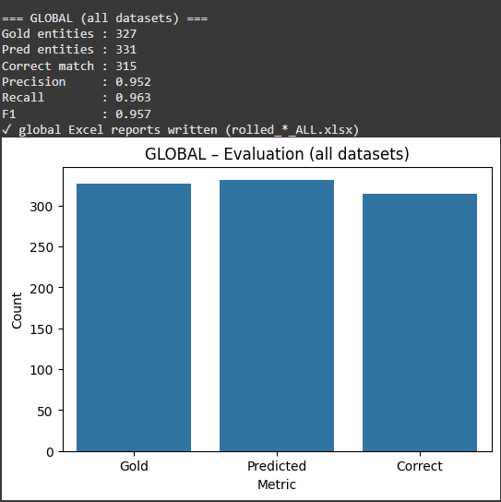
Results

Slide 7


Gemini 2.0 Flash
You are acting as an anonymizer, your job is to anonymize any message I send you. The key things you need to do:
1. identify names in the message, and swap those name with a special token.
2. identify addresses in the message, and swap those with a special token.
3. identify urls in the messages and swap those with a special token.
4. identify and remove months from birthdays, watch out for hebrew months!
5. identify and swap with a special token other parts of the message that can be used to identify the sender.
When you receive a message, you should return the same message anonymized based on the rule described above. names should be replaced with the `[NAME]` token, swap full names with only one token instead of multiple ones, addresses should be replaced with the `[ADDRESS]` token, dates and months should be replaced with the `[DATE]` token, any other idetifible information should be replaced with the `[SPECIAL]` token.

Slide 8

Matrix Protocol
GeminiAPI
II
System
ansible
terraform &VMs
Synapse

Slide 9
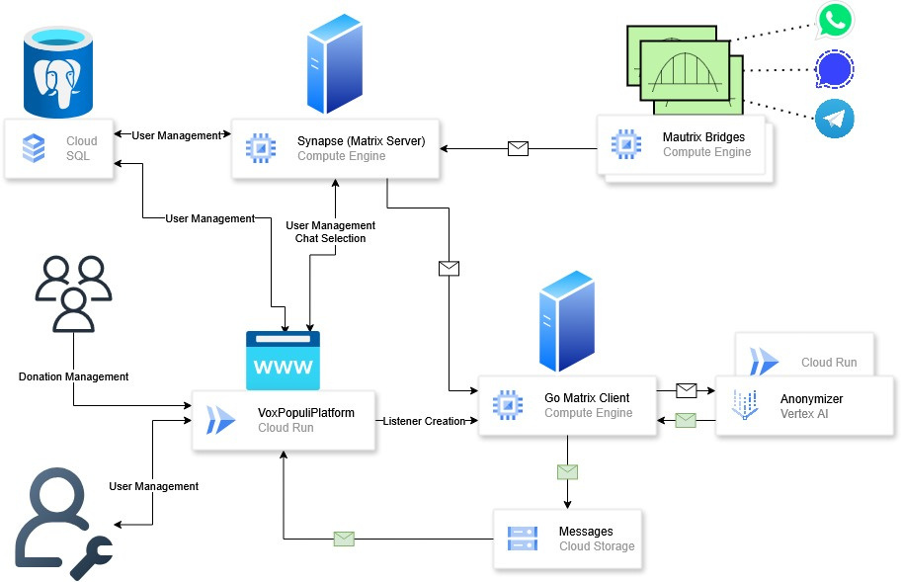






Slide 10
Streamlit
Cloud Run
III
User Interface
GCP Storage
Matrix API
PostgreSQL + Cloud SQL

Slide 11

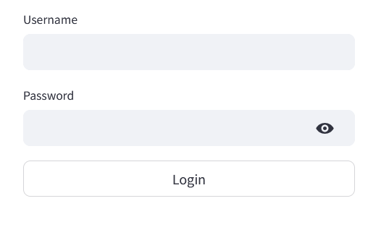
Login Page
Shows information about the platform
Login based on DB & server
Login redirects the user to user page or research page based on its role

Slide 12
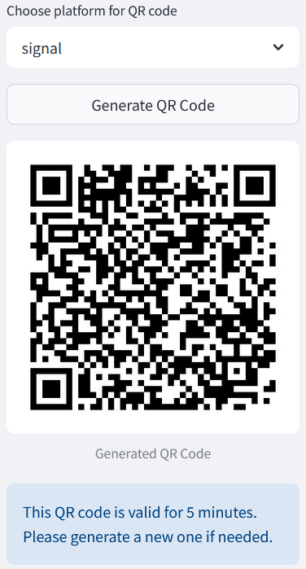
User - QR
Three options: Whatsapp, Signal, Telegram
Generation of QR code for whatsapp and signal
Confirmation code for Telegram

Slide 13
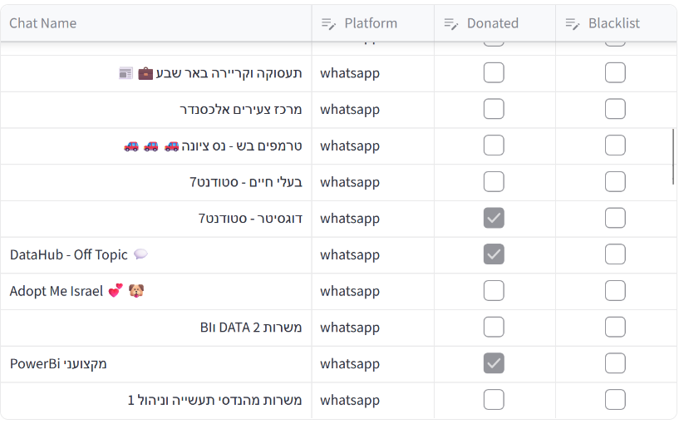
User - Chats
Shows all available chats
Allows filtering and searching
Allows to pick chats to donate
Allows blacklisting of chats

Slide 14
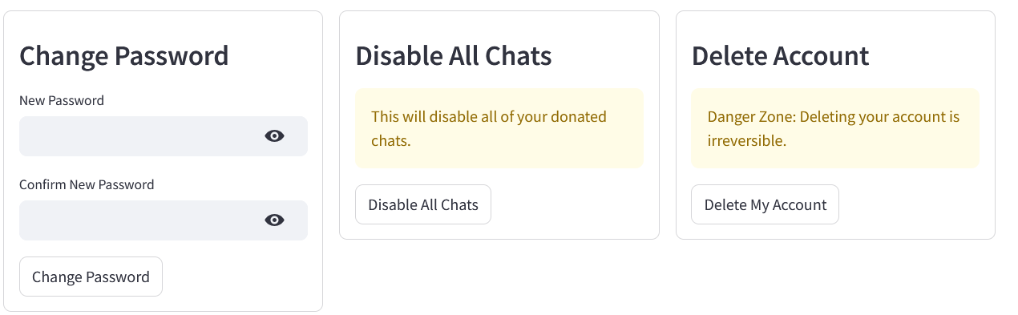
User - Settings
Changes password (both web app and server)
Disable all chats
Delete Account (both web app and server)

Slide 15
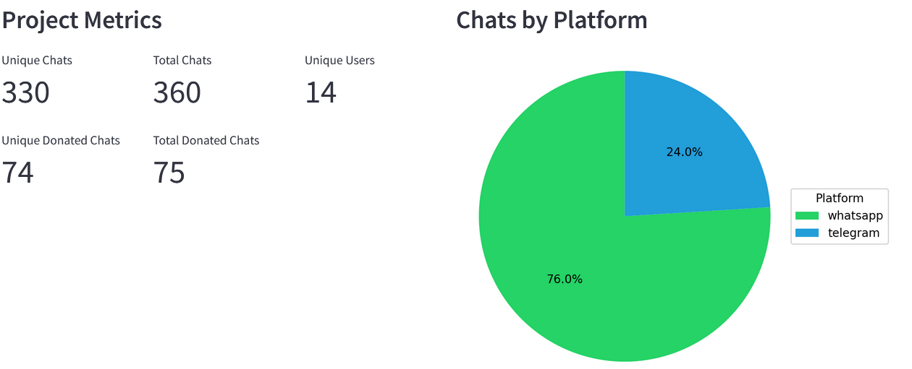
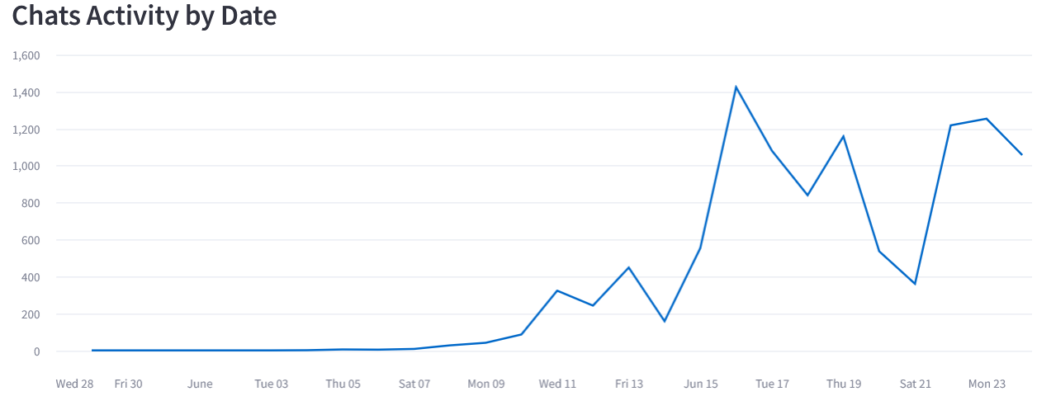
Researcher -
Chats Overview

Slide 16
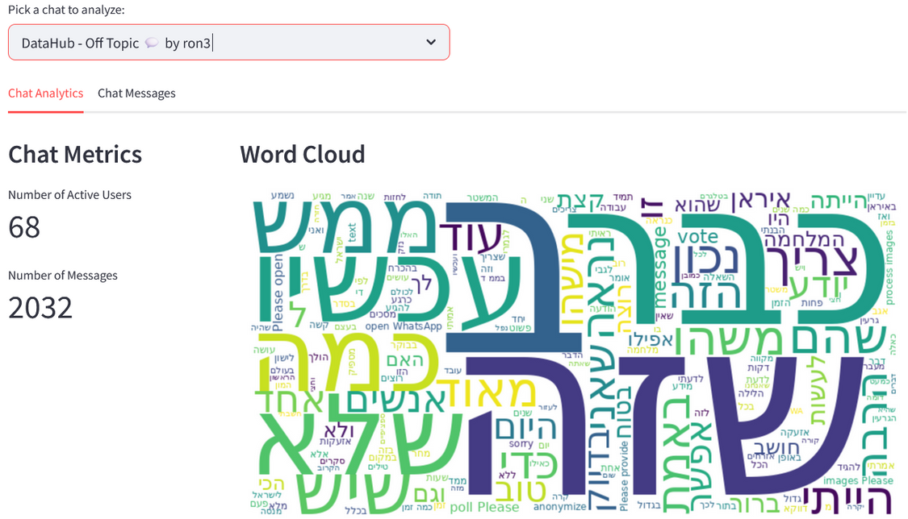
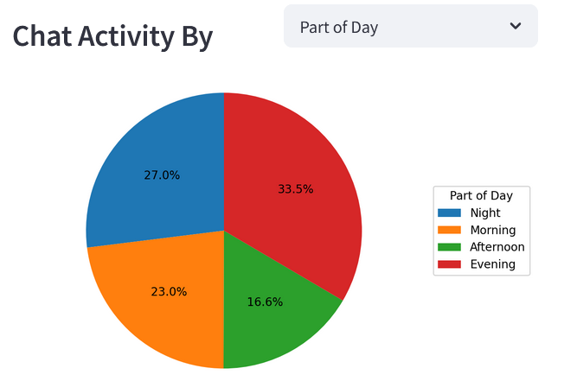
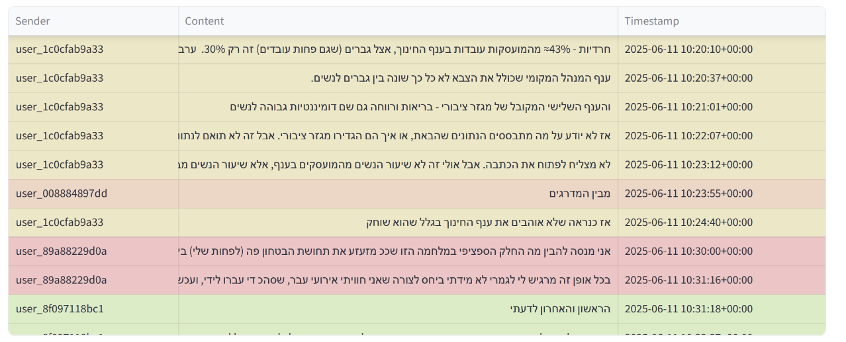
Researcher -
Chats Overview

Slide 17
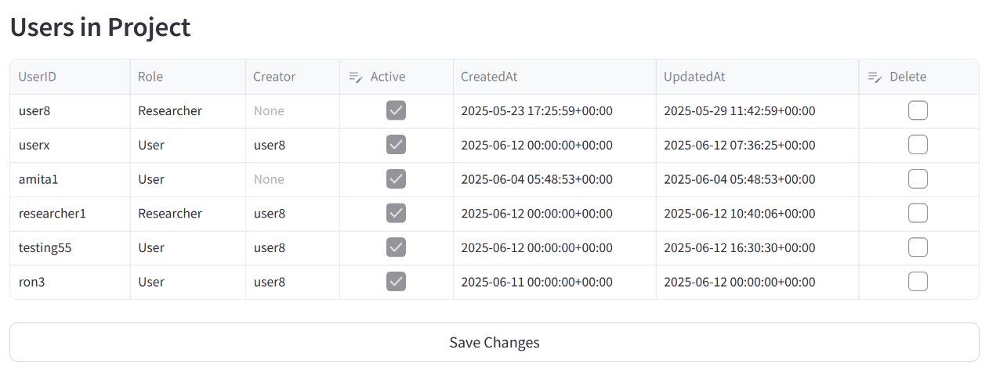
Researcher - User Managment
List of users
Disable users
Delete users

Slide 18
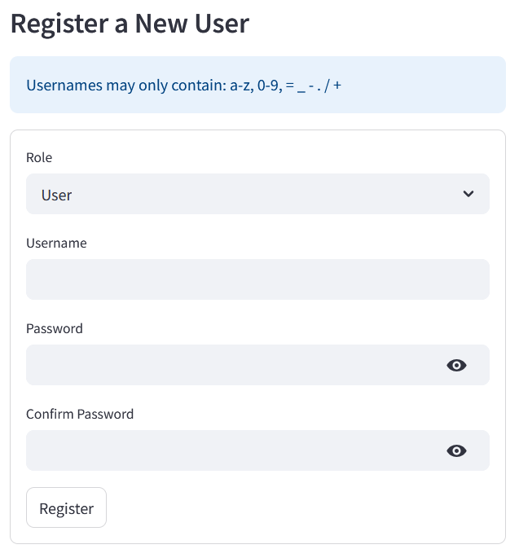
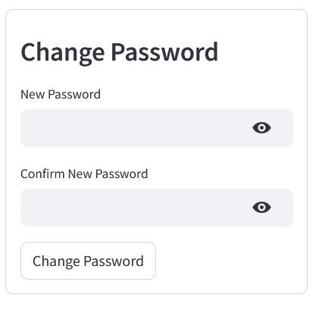
Researcher -
User Register& Change Password
Register new users (both WB and server)
Change password

Slide 19

Conducted over 72 hours with 10 participants
Tested server load, web app functionality, and message processing
We collected 75 chats and 10885 messages
Key findings:
• Server latency caused occasional
message processing delays
• Excessive use of buttons cause
server timeout for the users
Pilot

Slide 20
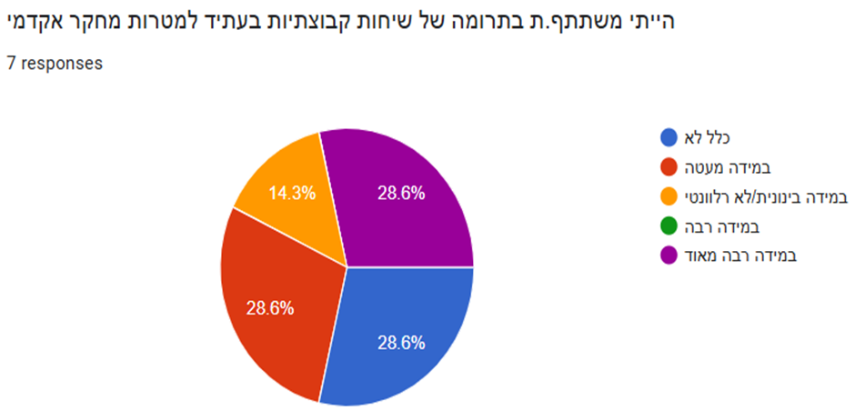
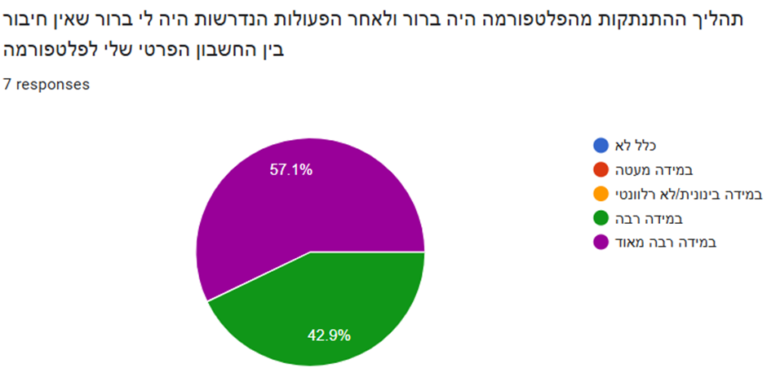

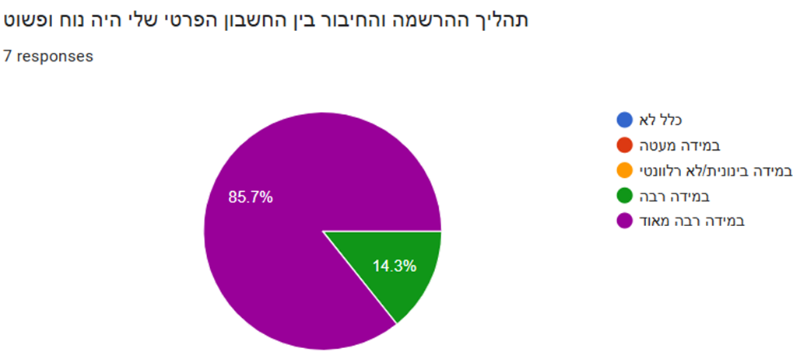
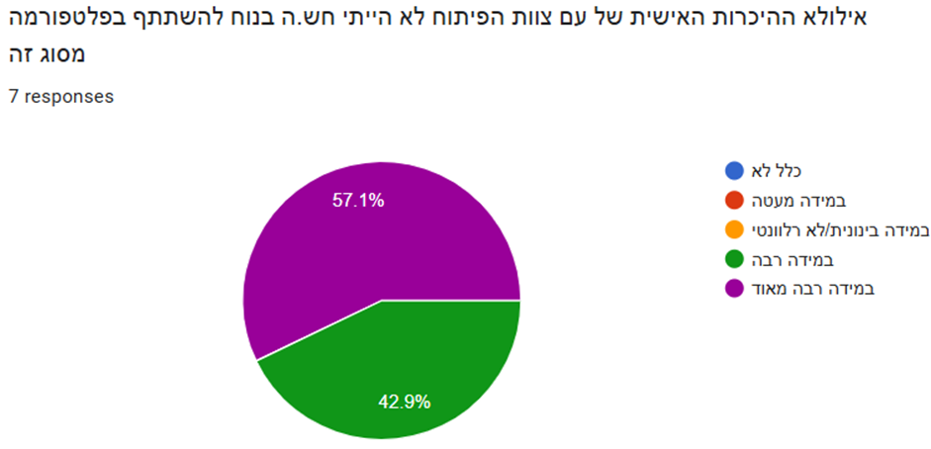
Post Pilot Survey

Slide 21
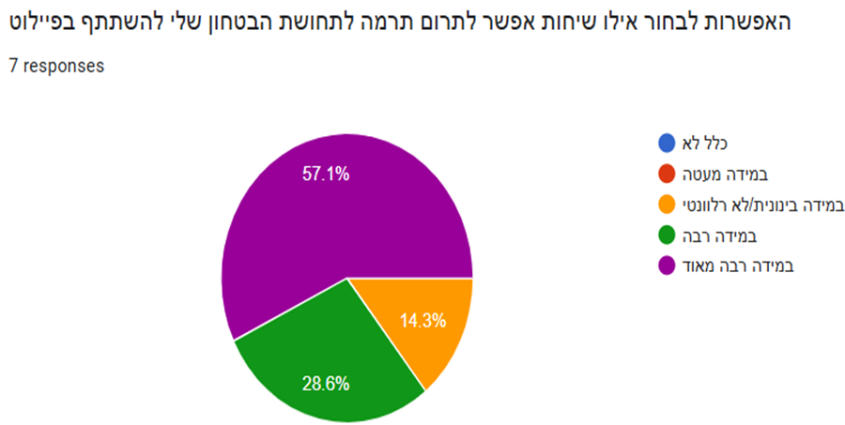
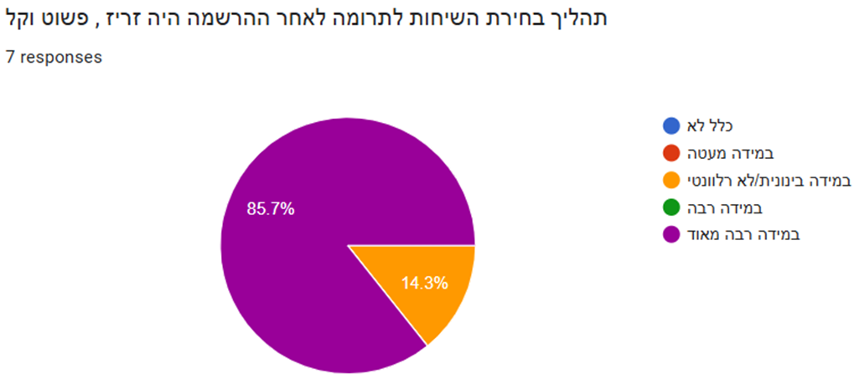
Post Pilot Survey

Slide 22
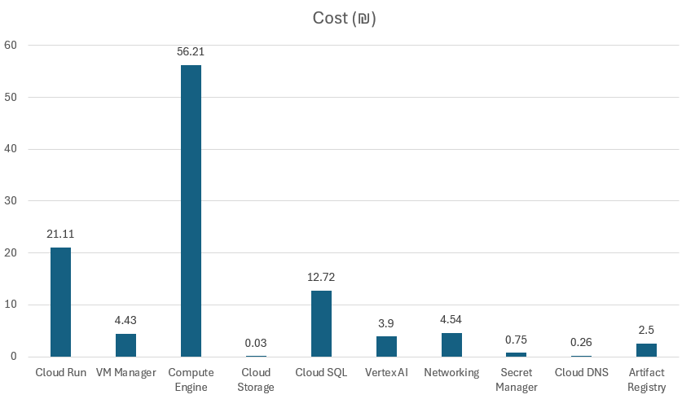
Pilot Expanses
Total of 106.45 NIS
Most expensive: Compute Engine
LLM Anonymizer was only 3.9 NIS

Slide 23



Thank You!

